Slide 1
A new restaurant in Birmingham, UK
Finding the popular cuisines and best neighbourhoods using data science

Slide 2
Introduction
Business problem
Target audience
Technical specification
Data

Slide 3
Business problem
An investor located in Birmingham is currently interested in adding a restaurant to his list of assets. The investor is aware of a few entrepreneurs looking to open new restaurants in this area, and in order to support his choice in choosing the right project, he would like to know:
What cuisines he should look into investing
Which neighbourhoods he should consider
The investor is looking to a neighbourhood that is growing, therefore, the most popular neighbourhoods in the city will not be considered.

Slide 4
Target audience
Anyone looking to invest in a restaurant in Birmingham.

Slide 5
Technical specification
This project was executed using data science concepts and Watson Studio as a cloud environment to process the data using Python as programming language.
The following tools and techniques were used:
Web scrapping is a mean employed to collect information from web pages
The kMeans clustering, which is a machine learning algorithm, is a method that classifies items based in their similarities
The FourSquare API is a tool to retrieve data from foursquare based on geolocation
Watson Data API, which is a tool to manipulate the components in Watson Studio projects.
Python libraries, which are a collection of pre-defined functions and methods.

Slide 6
Technical specification
The following Python libraries were used along the project:
Pandas was used to manipulate and analyse the data
Beautiful Soup was used to collect information from web pages
Folium was used to create the maps visualisations
Plotly was used create interactive graphs
Geopy.geocoders
kMeans from Sklearn
Numpy
Matplotlib

Slide 7
Data
The following data was used in this project:
List of neighbourhoods in Birmingham from Wikipedia: The data was scrapped from Wikipedoa.
Foursquare API: The API was used to collect information of food venues in a radius of 500 metres from the centre of each neighbourhood.
The data collected from Wikipedia and from the Foursquare API was stored in a comma-separated values file (.CSV) to be used as reference in the project.

Slide 8
Methodology
Data analyses

Slide 9
Methodology

Slide 10
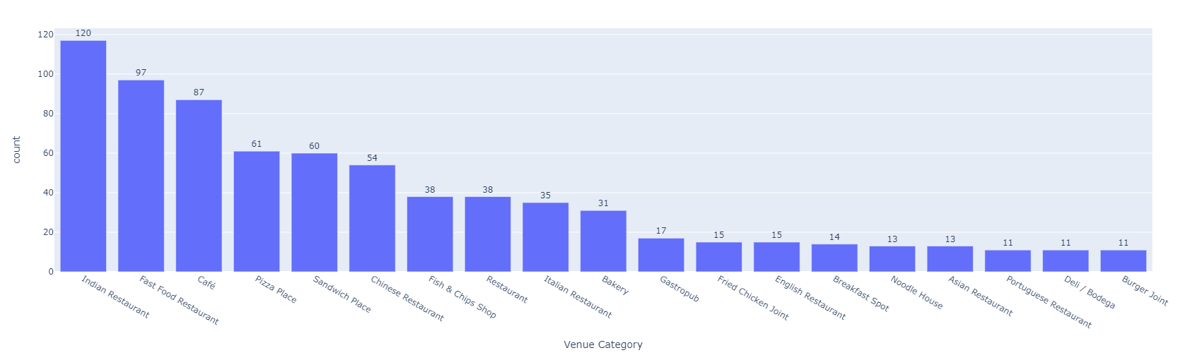
Most popular cuisine
Using the list of neighbourhoods and the venues retrieved using the Foursquare API, it is possible to extract a visualisation of the most frequent cuisines in Birmingham.
As some venues are not directly linked to a specific cuisine, I will consider only Indian, Chinese and Italian cuisines as the most popular cuisines for this project.

Slide 11
Elbow method

Slide 12
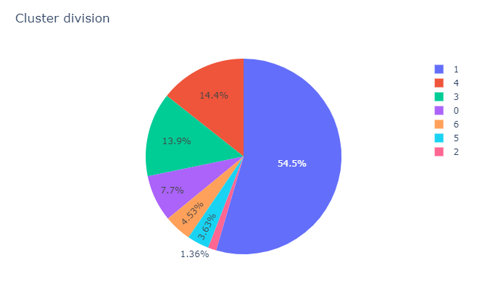
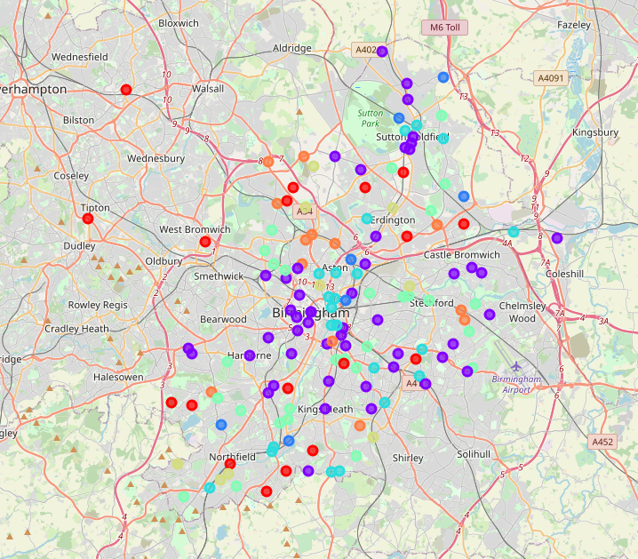
Clusters

Slide 13
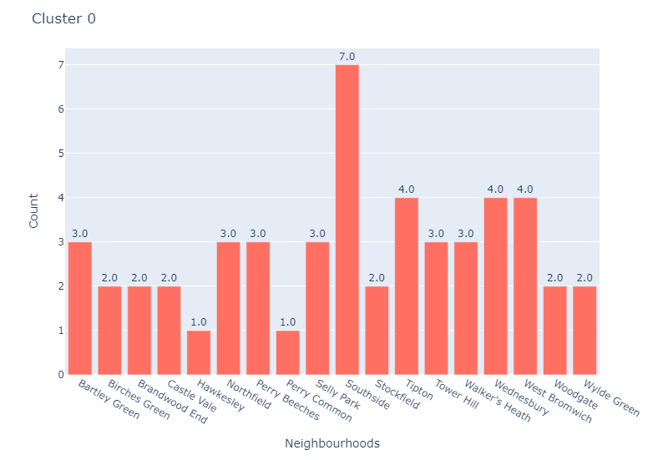
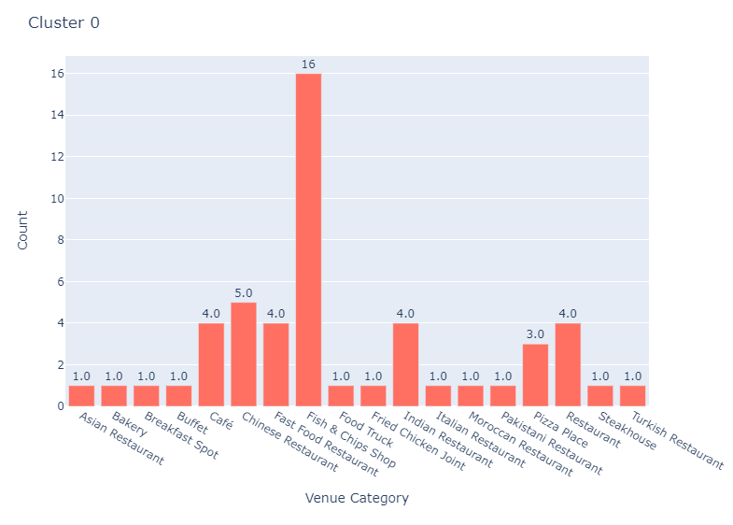
Cluster 0
This cluster has a good variety of cuisines with an average of 2.8 restaurants per neighbourhood. It has a good amount of Chinese and Indian restaurants, but no Italian restaurant.

Slide 14
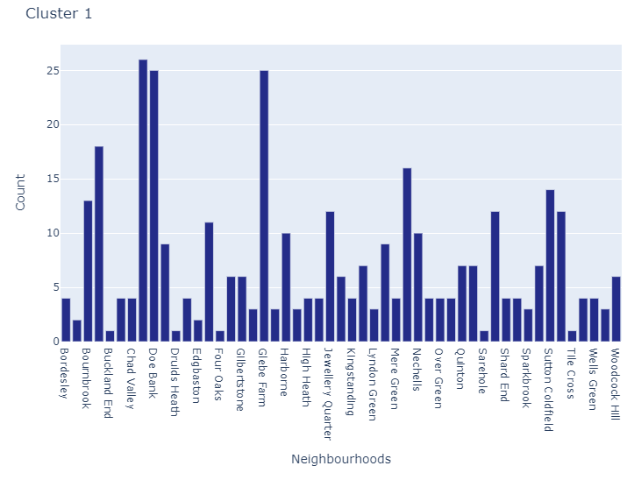
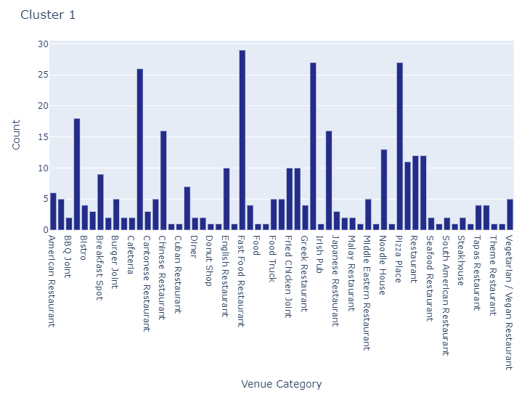
Cluster 1
This cluster has the biggest amount of neighbourhoods and venues and we can conclude those are the busiest neighbourhoods, so if an investor wants to open a restaurant in a well established gourmet area, he should probably explore the neighbourhoods in this area.

Slide 15
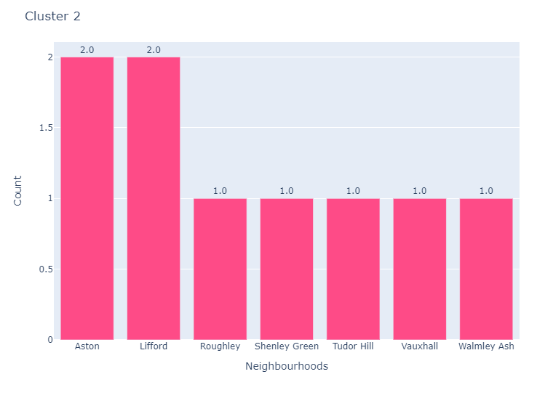
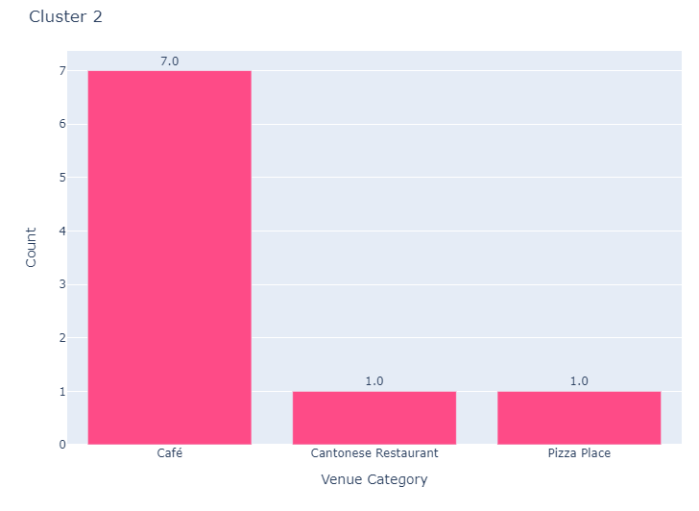
Cluster 2
This cluster has the neighbourhoods with the less amount of venues and the lowest diversity of venues, so it is probably not a very popular area for eating out.

Slide 16
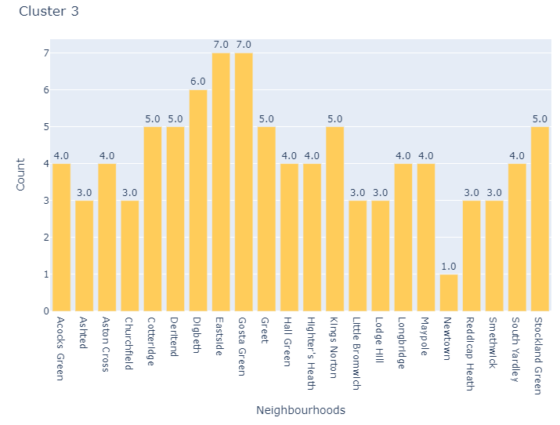
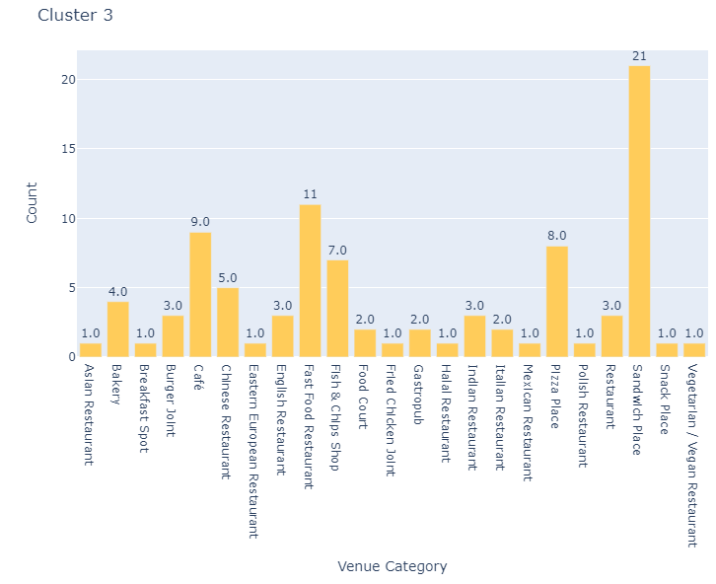
Cluster 3
The cluster 3 seems to have the neighbourhoods with an average of 4.1 restaurants per neighbourhood and with a good diversity of cuisines.

Slide 17
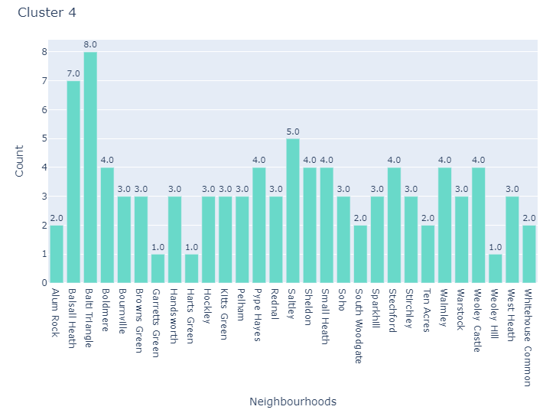
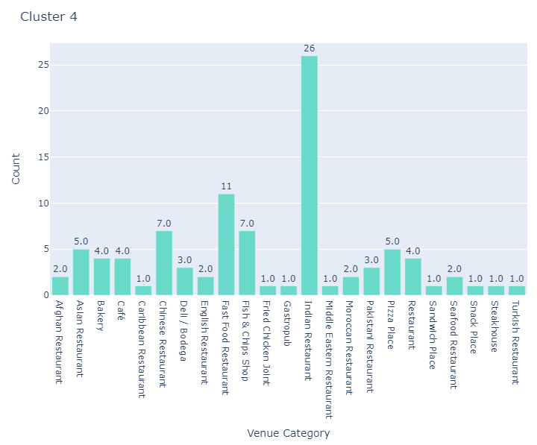
Cluster 4
This cluster seems to have the biggest concentration of Indian restaurants and with a good diversity of restaurants, but it has no Italian restaurant.

Slide 18
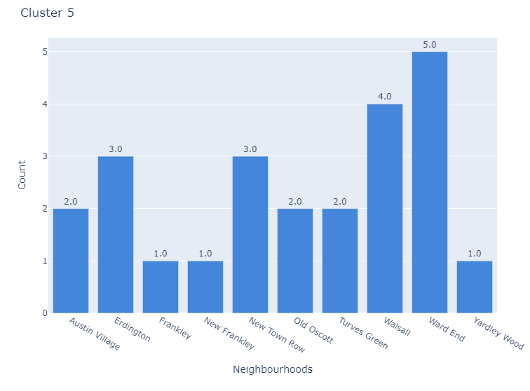
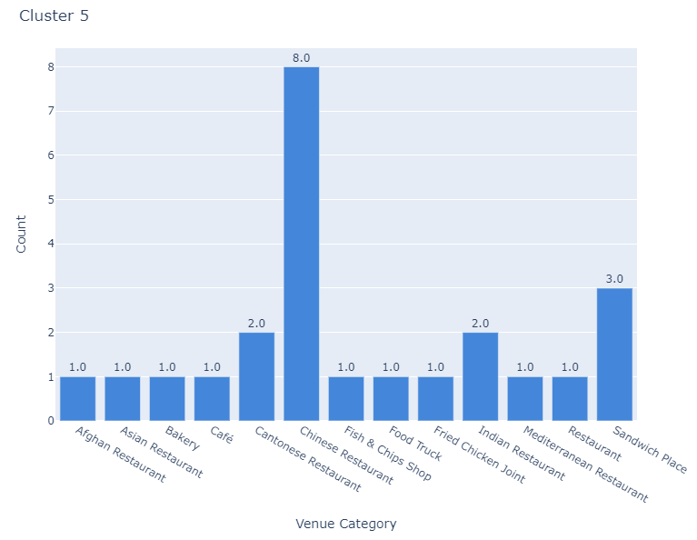
Cluster 5
This cluster has the biggest concentration of Chinese restaurants and again no Italian restaurant and an average of 2.4 restaurants per neighbourhood.

Slide 19
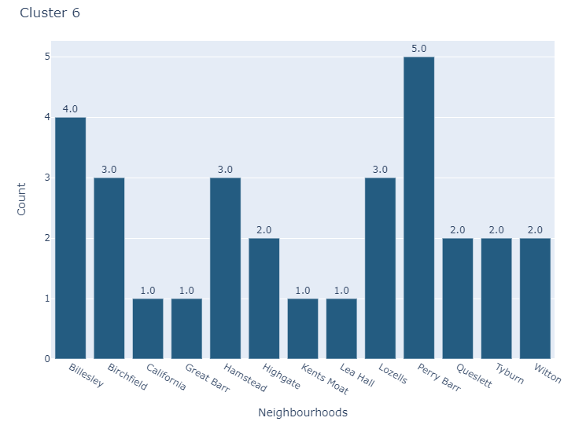
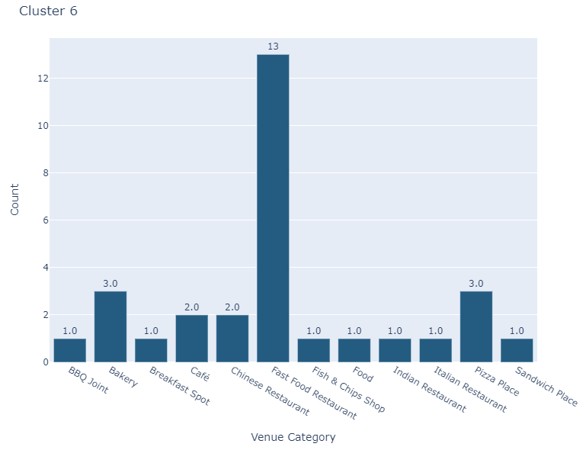
Cluster 6
This cluster has the biggest amount of fast food restaurants, which may indicate that people in this area are not very keen to go to restaurants for meals as a leisure activity.

Slide 20
results
Discussion and recommendations
Recommended neighbourhoods
Conclusion

Slide 21
Discussion and recommendations
Taking in consideration that:
The most popular cuisines in Birmingham are Indian, Chinese and Italian, being Italian the type of cuisine with the lowest amount of venues
The clusters 4 and 5 gather the neighbourhoods with a good average of restaurants and a good diversity of venue categories
The recommendation for the investor is to open an Italian restaurant. As the goal is to explore neighbourhoods where there is not much competition yet, I would recommend the neighbourhoods in the cluster 4 and 5, where the most popular neighbourhoods for restaurants are Ten Acres, Boldmere, Walsall and Erdington.

Slide 22
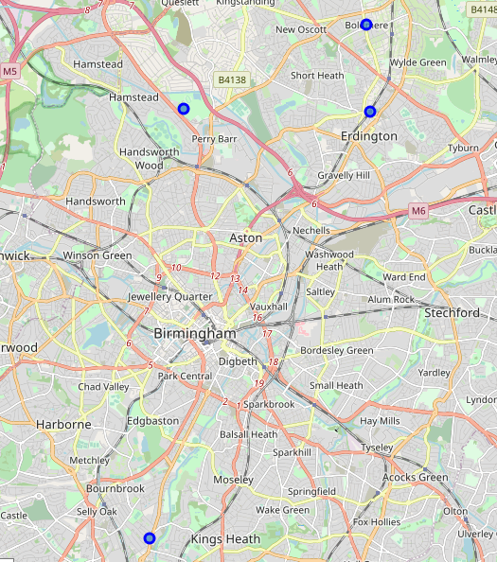
Recommended neighbourhoods

Slide 23
Conclusion
Birmingham is a very diverse city with a good amount of restaurants, and even though the most popular cuisine is Indian, there are many cuisines to explore in the area from different areas of Europe, Asia and even America.
Using the Foursquare API and machine learning to cluster the neighbourhoods allowed me to provide insights on what are the public preferences and also the best areas to invest.

Slide 24
Author
Leticia Pontes Farao Pires
Email: lpfpires@gmail.com
Linkedin: Leticia Pontes Farao Pires
GitHub: /lpfpires

